Slide 1
Chapter 4: Threads

Slide 2
Thread Concepts
Process-oriented computing
Multithreaded computing
code
files
data
code
files
data
thread
code
files
data
process
code
files
data
code
files
data
process
Operating System
Operating System

Slide 3

Single vs Multithreaded Processes
Processes
  Carries everything such as an address space, code, data, and files
  Heavyweight in terms of creation/termination/context switching
Threads
  Shares an address space, code, data and files if they belong to the same process
  Lightweight in terms of creation/termination/context switching
  Then, what is uniquely carried by each thread?

Slide 4
Benefits
Responsiveness
Deadlock avoidance
Scalability, (i.e., Utilization of multiprocessor architecture)
Resource sharing and economy
  Threads share an address space, files, code, and data
    Avoid resource consumption
    Perform much a faster context swtich

Slide 5

Benefit 1: Responsiveness
Multithreaded Server
Clients
Web Server
DB1
DB2
CGI
http
pages

Slide 6
Benefit 2: Deadlock avoidance
Process 1
Process 2
send
Bounded buffer
send
Bounded buffer
receive
receive
A sequence of send and then receive does not work!
Send and receive must be executed concurrently with threads.

Slide 7




Benefit 3: Utilization of multicore multiprocessor architecture
time = t
time = t + x
Place code, files and data in the main memory.
Distribute threads to each of CPUs, and
Let them execute in parallel.
time = t + 2x
code
files
data

Slide 8
Discussions 1
Why can threads perform their context switch much faster than processes? What data structure must threads carry by their own resource? What data structure can they share? What if we use processes rather than threads for the previous three cases?
  Responsiveness
  Deadlock avoidance
  Utilization of multiprocessor architecture
Provide one programming example of multithreading giving improved performance over a single-threaded solution.
Provide one programming example of multithreading that would not improve performance over a single-threaded solution.

Slide 9
User and Kernel Threads
User Threads
  Thread Management Done by User-Level Threads Library
  Examples
- POSIX Pthreads
- Win32 threads
- Java threads
  Kernel does not care how many user threads exist.
Kernel Threads
  Supported by the Kernel
  Examples
- Linux
- Windows XP/2000
- Solaris lightweight processes

Slide 10
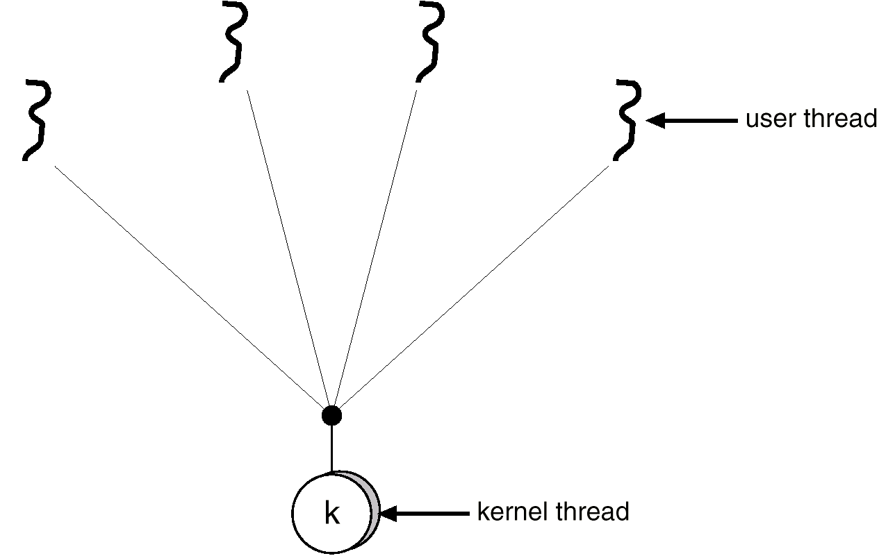
Many-to-One Model
Many user-level threads mapped to a single kernel thread.
Used on systems that do not support kernel threads.
Examples: Solaris Green Threads, GNU Portable Threads
Advantage: fast
Disadvantage: 1. Non preemption or very
complicated to handle
preemption and I/O
2. No use of MP architecture

Slide 11
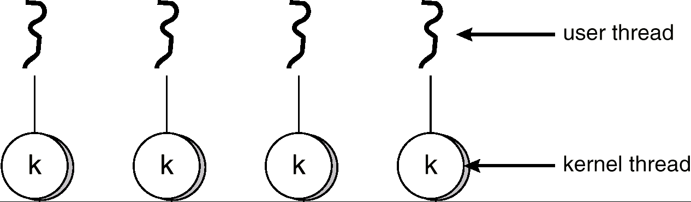
One-to-One Model
Each user-level thread maps to kernel thread.
Examples
- Windows NT/XP/2000
- Linux
- Solaris 9 or later
Advantage: everything is supported by OS.
Using MP architecture.
Disadvantage: slower than many-to-one model.
too many threads do not help.

Slide 12
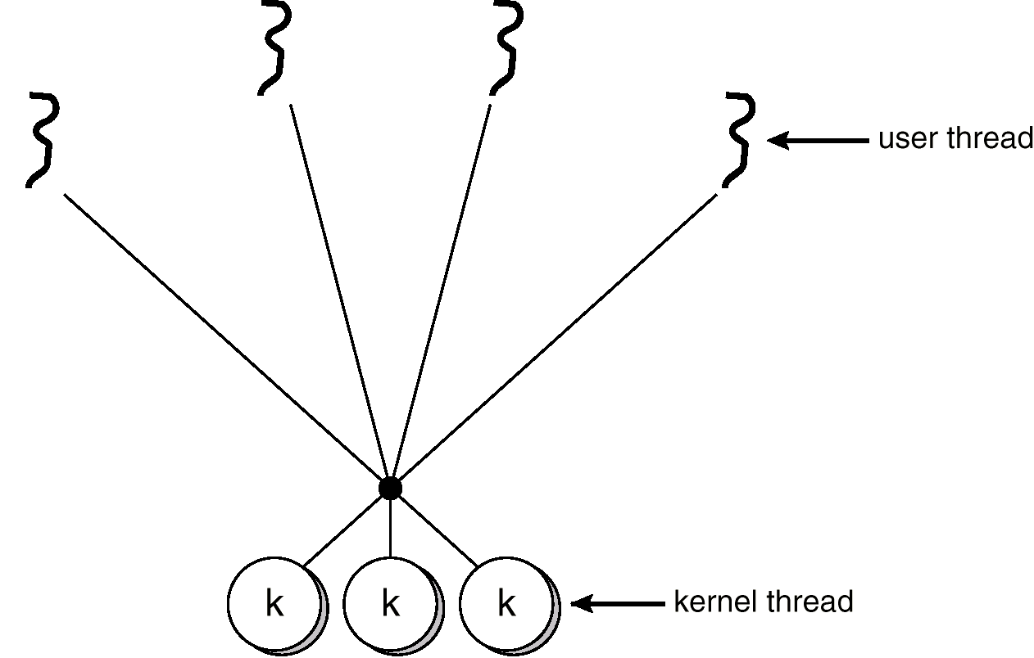
Many-to-Many Model
Covering the shortage of the previous two models
Examples: Windows XP’s fiber library, AIX Pthreads

Slide 13
Process Structure
Kernel schedules each light-weight process separately.
Traditional UNIX Process
Multithreaded Process
Process ID
Process ID
UID GID EUID EGID
UID GID EUID EGID
Directory Entry
Directory Entry
TTY
TTY
Signal Dispatch
Table
Signal Dispatch
Table
Memory Map
Memory Map
LWP1
LWP2
0
stdin
priority
0
stdin
LWP ID
LWP ID
1
stdout
Intr. mask
1
stdout
priority
priority
2
stderr
registers
2
stderr
Intr. mask
Intr. mask
3
3
registers
registers
CPU Status
File Descriptors
File Descriptors
From MultiThreads Text: p37

Slide 14
Thread Structures
Process
Thread library runs in a user space.
All threads shared the same address space.
Each thread maintains its own information and stack space.
Once a thread is mapped to a LWP, it runs on a CPU.
Thread3
thread info
Java Threads
stack
red zone
thread info
Thread2
stack
JVM
Thread1
red zone
thread info
stack
red zone
Thread ID
Thread ID
Thread ID
priority
priority
priority
PC
PC
PC
SP
SP
SP
heap
Other regs
Other regs
Other regs
Thread1
Thread2
Thread3
code + global data
Pthreads
Win32 threads
Thread to LWP mapping
User mode
Process ID
LWP ID
LWP ID
Kernel mode
UID GID EUID EGID
priority
priority
Directory Entry
Intr. mask
Intr. mask
TTY
registers
registers
LWP1
LWP2
Signal Dispatch
Table
Memory Map
File Descriptors

Slide 15
Pthreads
A POSIX standard (IEEE 1003.1c) API for thread creation and synchronization
API specifies behavior of the thread library, implementation is up to development of the library
Common in UNIX operating systems (Solaris, Linux, Mac OS X)

Slide 16
Pthreads
Compilation and Execution
public class MyThread {
public static void main( String args[] ) {
String arg = args[0];
ThreadFunc child = new ThreadFunc( arg );
child.start( );
for ( int i = 0; i < 10; i++ ) {
try {
Thread.sleep( 1000 );
} catch ( InterruptedException e ) { };
System.out.println( "I'm a master: " + arg );
}
try {
child.join( );
} catch ( InterruptedException e ) { };
System.out.println( "Master synched with slave" );
}
}
public class ThreadFunc extends Thread {
public ThreadFunc( String param ) {
this.param = param;
}
public void run( ) {
for ( int i = 0; i < 5; i++ ) {
try {
Thread.sleep( 2000 );
} catch ( InterruptedException e ) { };
System.out.println( "I'm a slave: " + param );
}
}
String param;
}
MyThread.java
$ ls
MyThread.java ThreadFunc.java
$ javac MyThread.java
$ java MyThread hello!
I'm a master: hello!
I'm a slave: hello!
I'm a master: hello!
I'm a master: hello!
I'm a slave: hello!
I'm a master: hello!
I'm a master: hello!
I'm a slave: hello!
I'm a master: hello!
I'm a master: hello!
I'm a slave: hello!
I'm a master: hello!
I'm a master: hello!
I'm a slave: hello!
I'm a master: hello!
Master synched with slave
$
ThreadFunc.java

Slide 17
Java Threads
Java threads may be created by:
  Extending thread class
  Implementing the Runnable interface

Slide 18
Thread Class Extension
class Worker1 extends Thread
{
public void run() {
while ( true )
System.out.println(“I am a Worker Thread”);
}
}

Slide 19
Thread Creation 1
public class First
{
public static void main(String args[]) {
First main = new First( );
}
First( ) {
Worker1 runner = new Worker1();
runner.start();
while ( true )
System.out.println(“I am the main thread”);
}
}

Slide 20
Runnable Interface Implementation
// This Runnable interface has been defined by system
public interface Runnable
{
public abstract void run();
}
// You have to actually implement the run method.
class Worker2 implements Runnable extends myBaseClass
{
public void run() {
while ( true )
System.out.println(“I am a Worker Thread”);
}
}

Slide 21
Thread Creation 2
public class Second
{
public static void main(String args[]) {
Second main = new Second( )
}
Second( ) {
Runnable runner = new Worker2();
Thread thrd = new Thread(runner);
thrd.start();
while ( true )
System.out.println(“I am the main thread”);
}
}

Slide 22
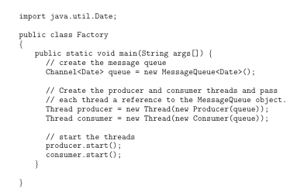
Java Threads
Producer-Consumer

Slide 23
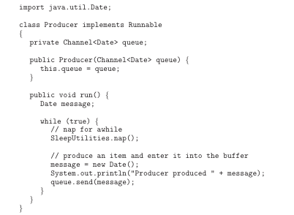
Java Threads
Producer
CSS430 Threads

Slide 24
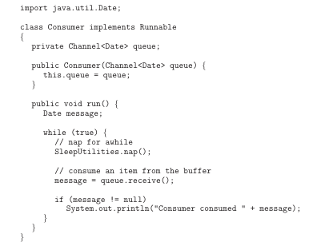
Java Threads
Consumer

Slide 25
Java Thread Management
setPriority( ) – changes this thread’s priority.
suspend() – suspends execution of the currently running thread.
sleep() – puts the currently running thread to sleep for a specified amount of time.
resume() – resumes execution of a suspended thread.
stop() – stops execution of a thread.
Suspend, resume, and stop are currently deprecated in the specification. (However, we will use for Assignment 2.)
For more information, visit:
  http://java.sun.com/j2se/1.4/docs/api/index.html

Slide 26

Java Thread States

Slide 27
Discussions 2
Why does the latest Java compiler deprecate the use of resume, suspend, and stop? Consider an undesired situation incurred when those three functions are used.
Code a Java thread corresponding to a Pthread example on page 16. If we omit a join( ) statement in the both version, what happened to them. Do we observe any difference between Pthread and Java?

Slide 28
Demo ThreadJoinExample.java

Slide 29
Exercises (No turn-in)
Consider the following five options to implement synchronization between producer and a consumer, both accessing the same bounded buffer. When we run a producer and a consumer on shared-memory-based dual-processor computer, which of the following implementation is the fastest? Justify your selection. Also select the slowest implementation and justify your selection. (After you have studied synchronization, come back here and solve this exercise.)
User the many-to-one thread mapping model, allocate a user thread to a producer and a consumer respectively, and let them synchronize with each other using test-and-set instructions.
Use the many-to-one thread mapping model, allocate a user thread to a producer and a consumer respectively, and let them synchronize with each other using semaphore.
User the one-to-one thread mapping model, allocate a user thread, (i.e., a kernel thread) to a producer and a consumer respectively, and let them synchronize with each other using test-and-set instructions.
User the one-to-one thread mapping model, allocate a user thread, ( i.e., a kernel thread) to a producer and a consumer respectively, and let them synchronize with each other using semaphores.
Allocate a different process to a producer and a consumer respectively, and let them synchronize with each other using semaphores. (Note that a bounded buffer is mapped onto the shared memory allocate by those processes through shmget and shmat.)

